Slide 1


Travelers Competition
Auto Quote Conversion Model

Slide 2
Agenda
Problem Statement
Process flow
Data Exploration
Data Modeling
Recommendations

Slide 3
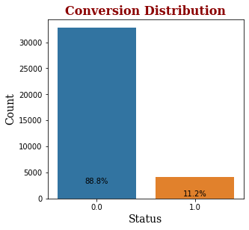
Problem Statement
Quote conversion rate of Peace of Mind Insurance company is just over 11%.
Personal automotive insurance Department of the company wants to build a model with the goal of understanding the pool of customers who are likely to convert over its competitors

Slide 4






Process Flow
Data Pre-processing
Data Exploration
Model Development
Results and Interpretation
?
Data Cleansing
Data Transformation
Data Exploration
Develop Model to
Predict propensity score
Measure model KPIs of Model
Interpretation
Conclusion
Select key metrics and perform outlier and missing values treatment
Create new columns required for analysis
Univariate and Bivariate analysis
Hypothesis Testing
Data Split
Oversampling
Develop classification models
Check accuracy and other model results
Interpret the model results with business needs
Recommendations

Slide 5
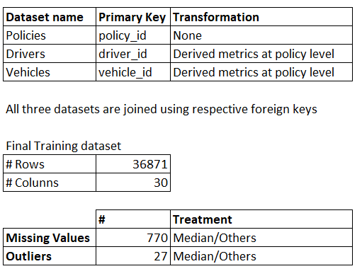
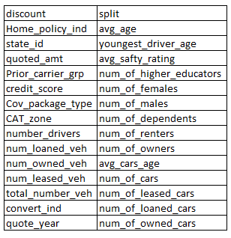
Data Pre-Processing
Final list of columns
Primary Key – Policy ID

Slide 6

DATA EXPLORATION

Slide 7
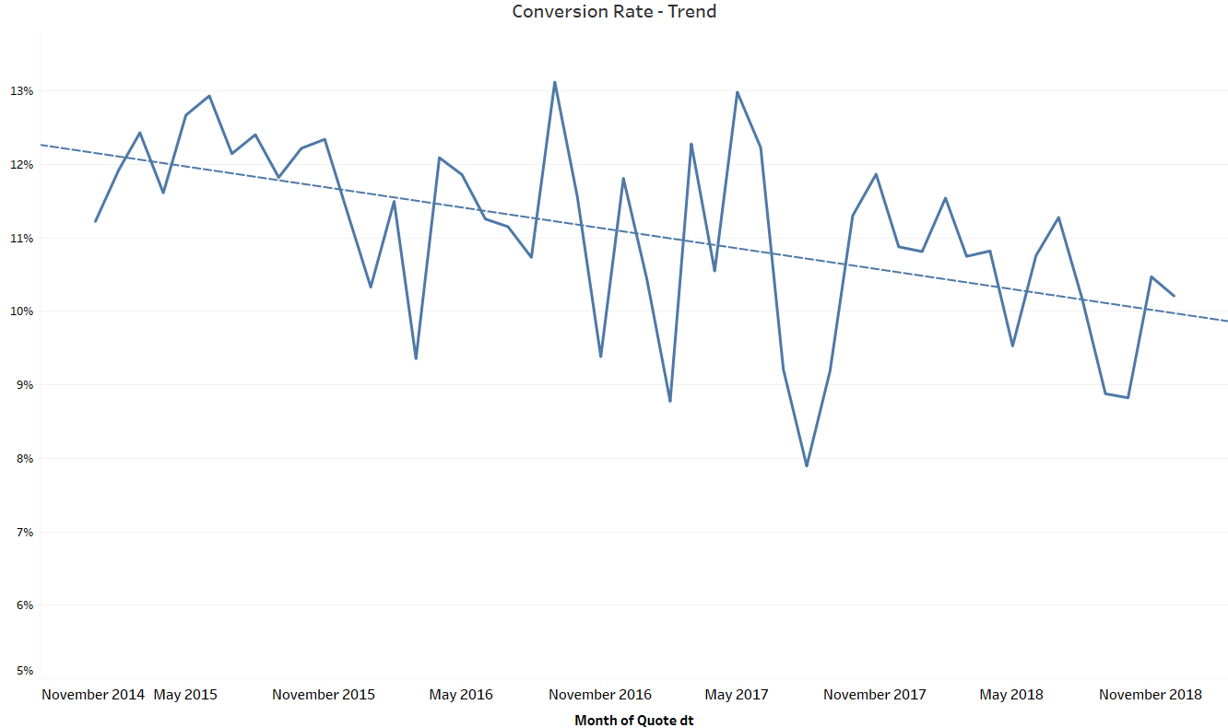
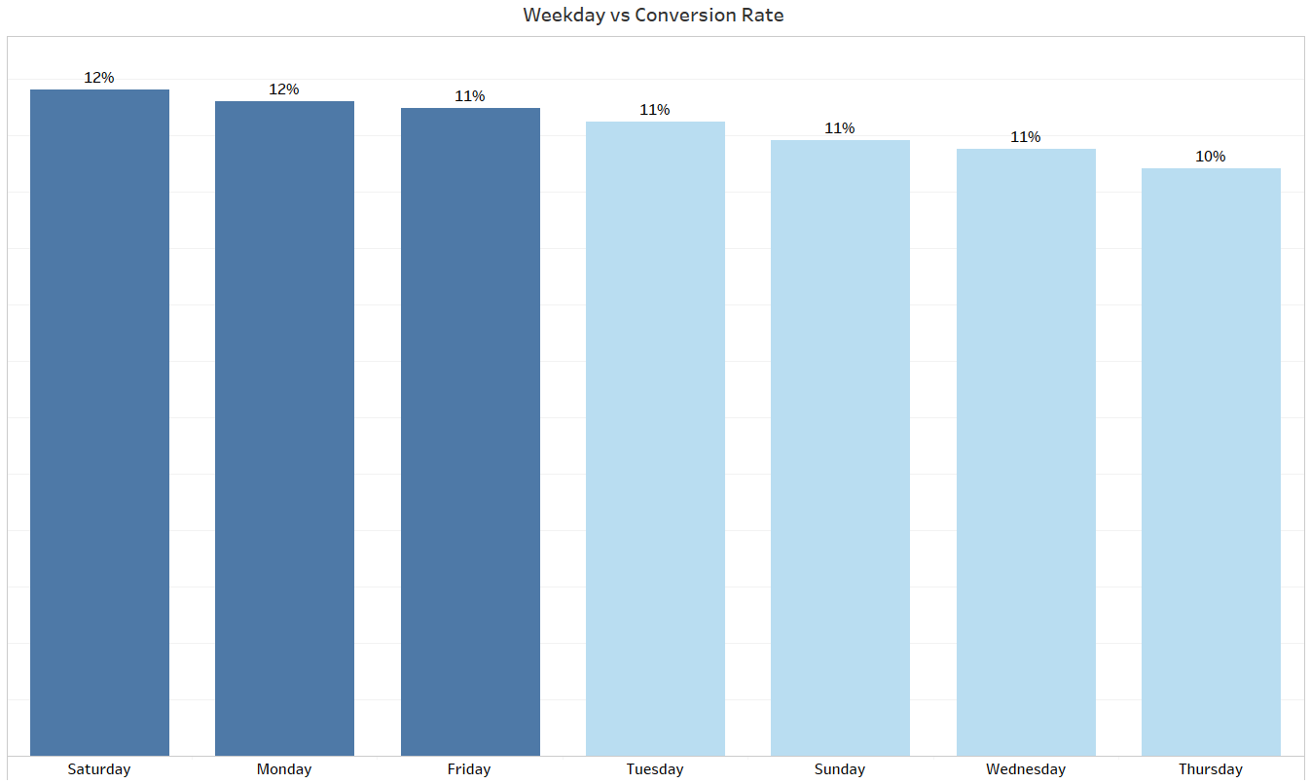
Conversion rate has been steadily decreasing since 2015
Conversion rate in 2018 is 10% lower by 2% compared to 2015
Quotes released during mid of the week has lower conversion rate

Slide 8
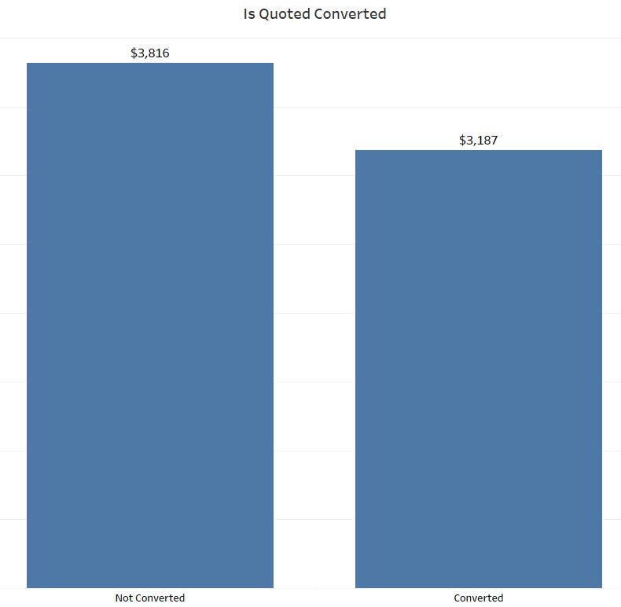
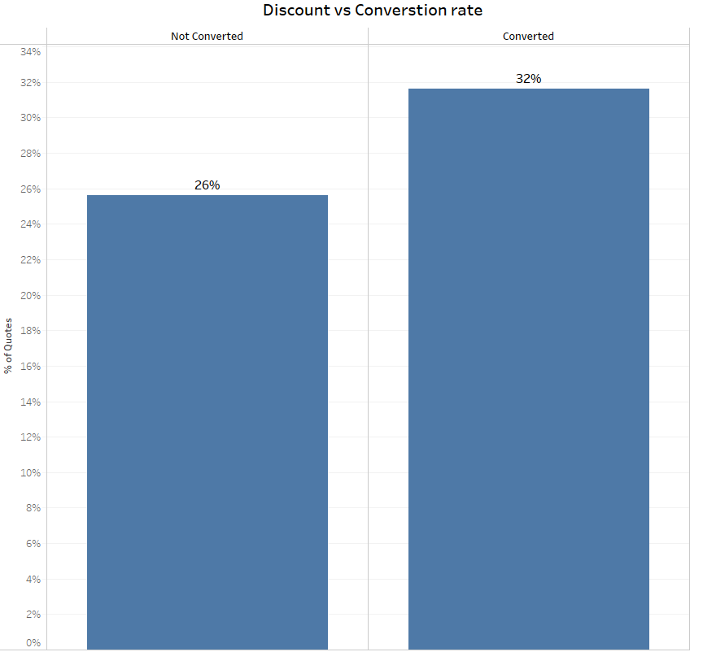
Policies with discounts and lower quoted amounts have better conversion rates
Median cost of a converted policy is 16% lower than policy which is not converted
25% of policies are provided with discount
Policies provided with discount are having 6% higher conversion rate

Slide 9
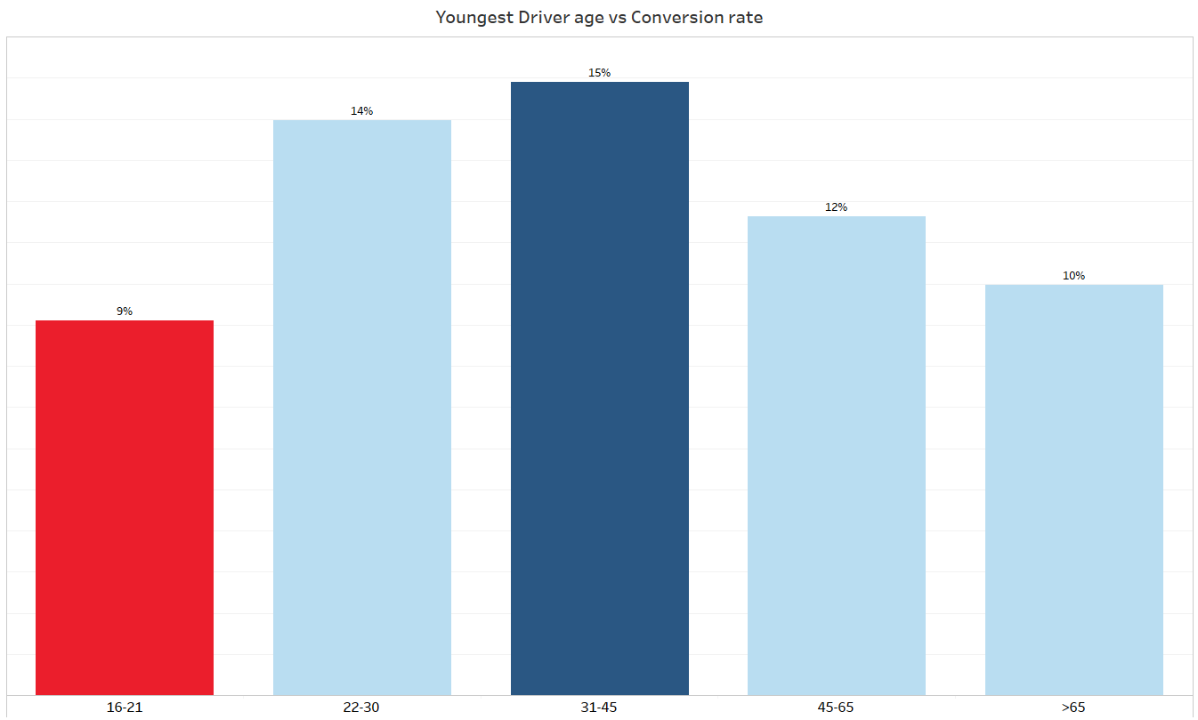
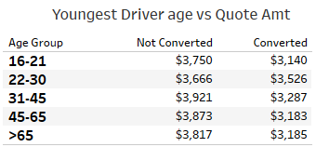
Irrespective of cost, families having young drivers have lower conversion rate compared to families with experienced drivers

Slide 10
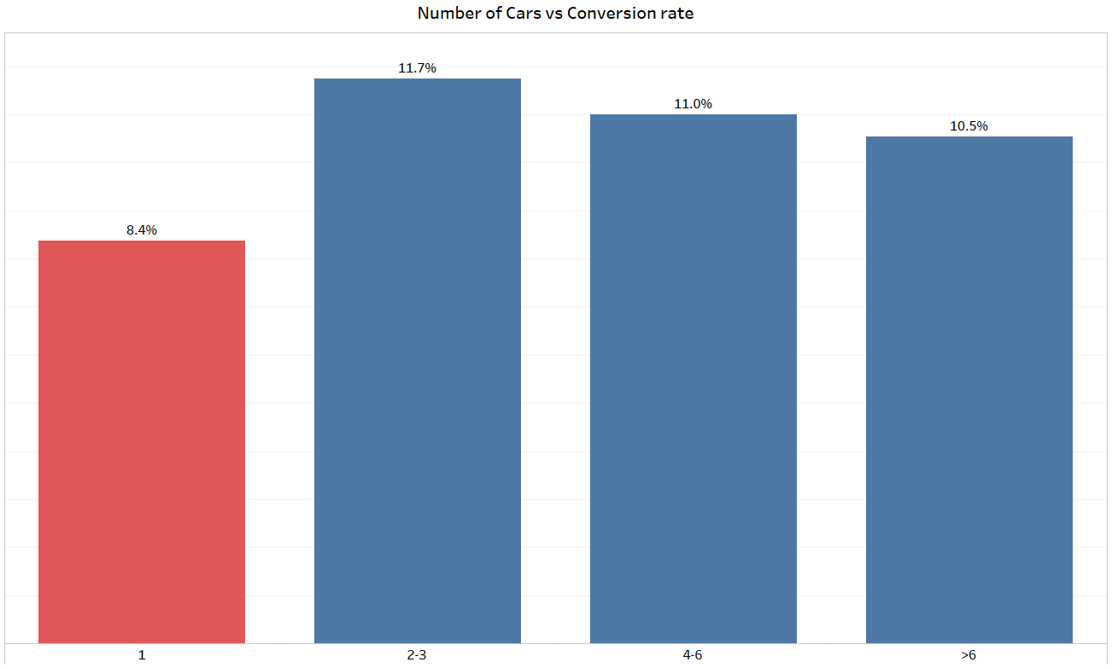
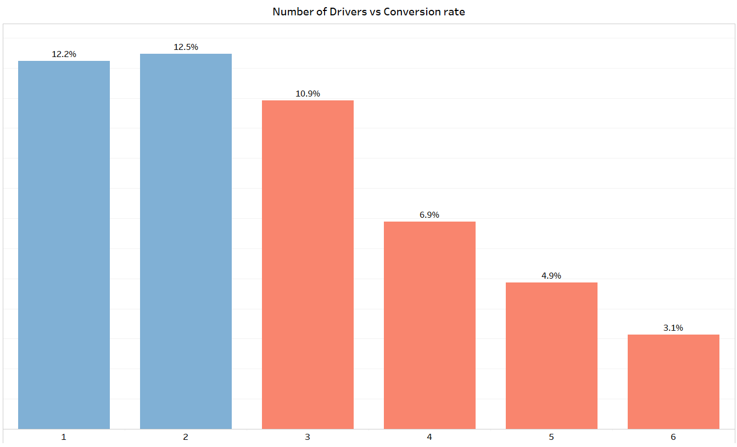
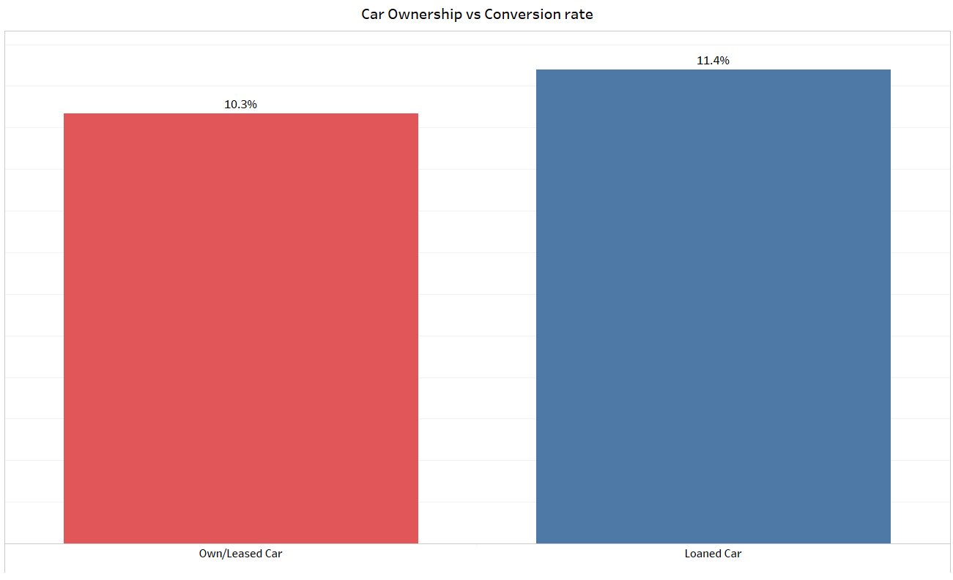
Policy holders with families having more cars but less drivers have higher conversion rate.

Slide 11
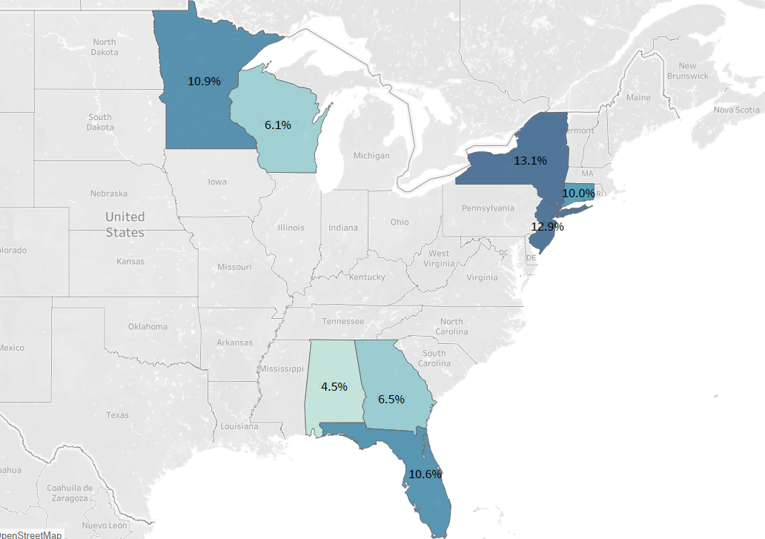
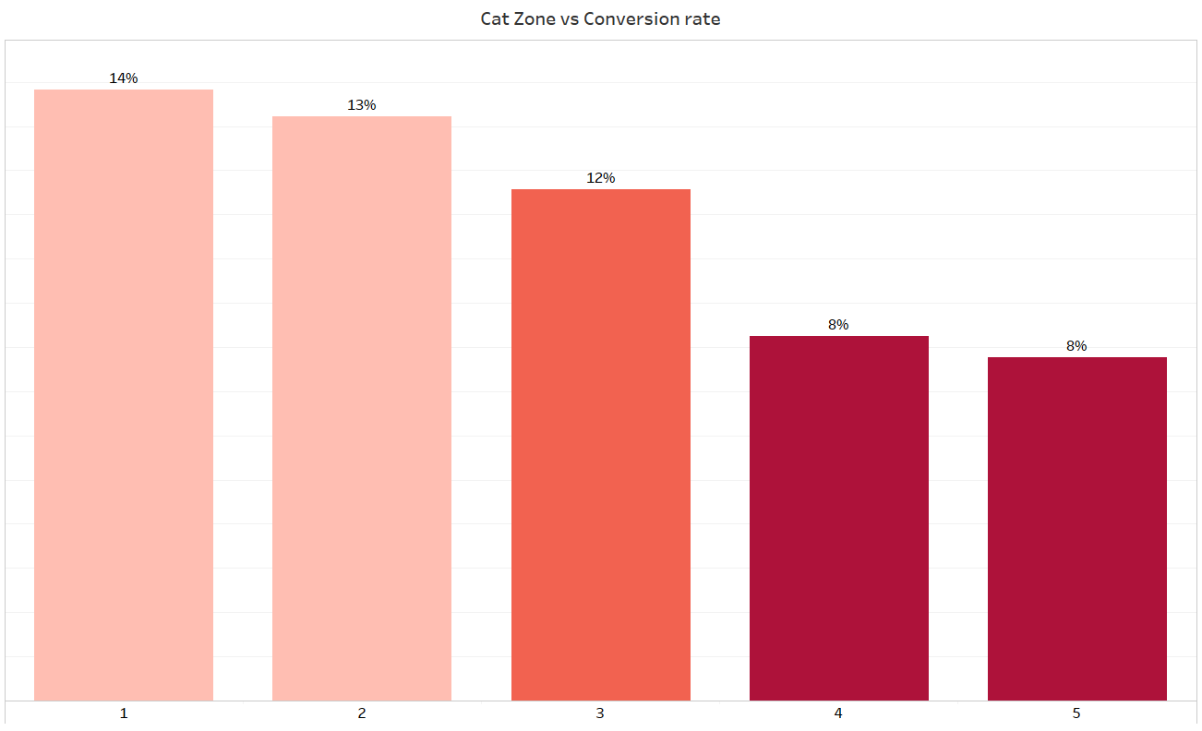
Policy holders based out of Alabama and CAT Zone 4-5 have lower chance of converting the quotes
Policy holders belonging to NY state have 2% higher conversion rate than average
Policy holders belonging to CAT Zone (4-5) have 3% less chance of conversion rate

Slide 12
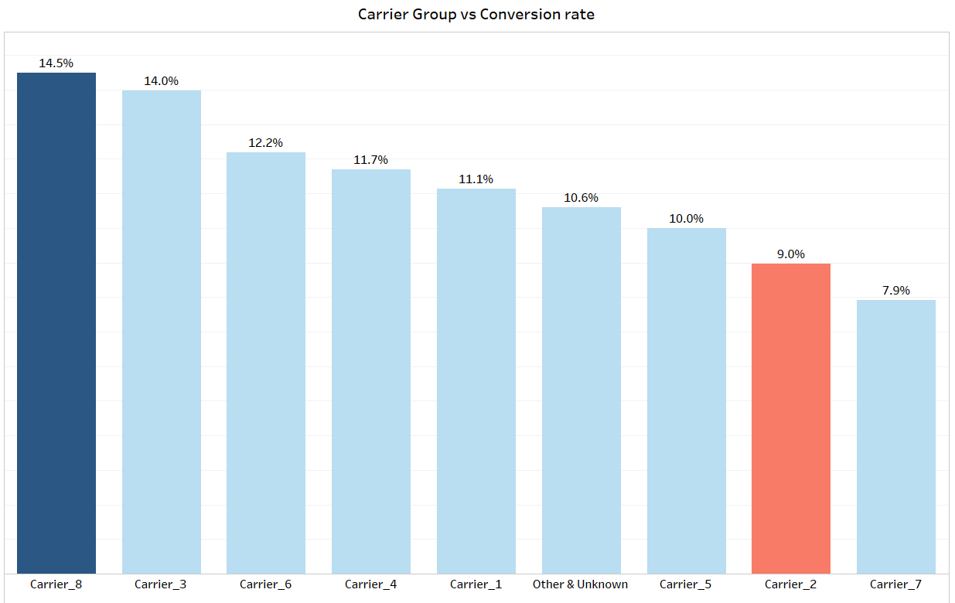
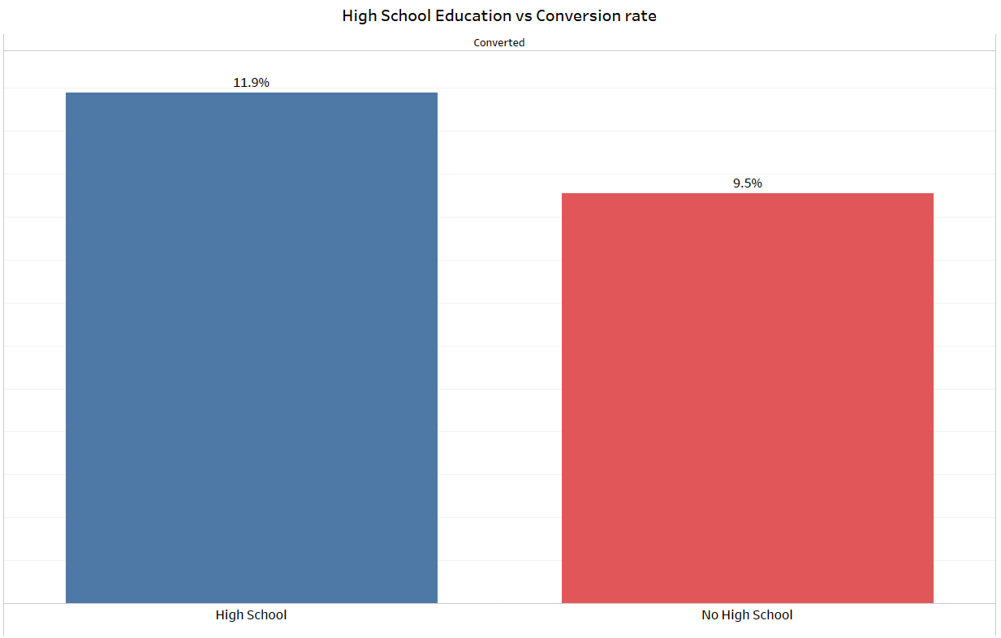
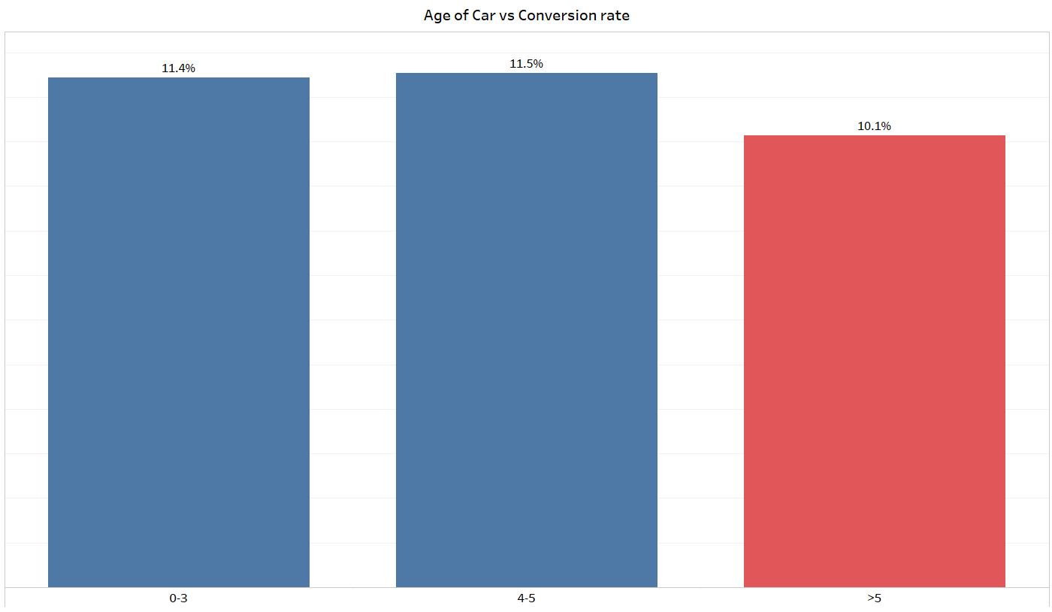

Carrier 8 related quotes have highest conversion rate
Families having at least one person going to high school has 2% higher chance of conversion
Policy holders having cars of more than 5 years old are less likely to convert the quote

Slide 13


Slide 14
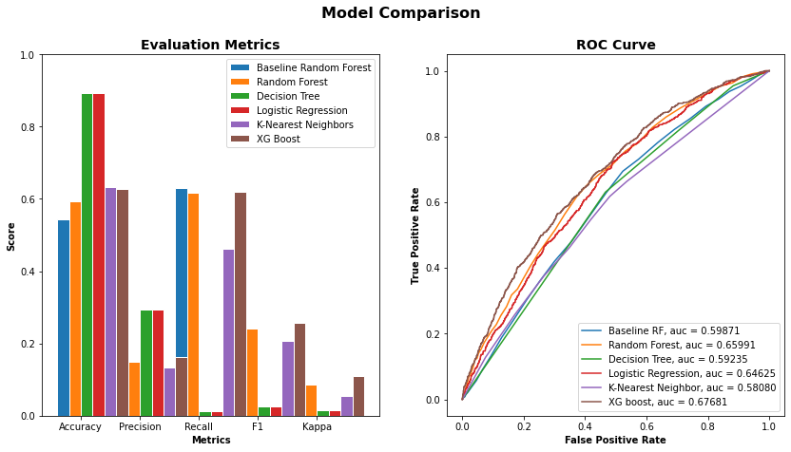
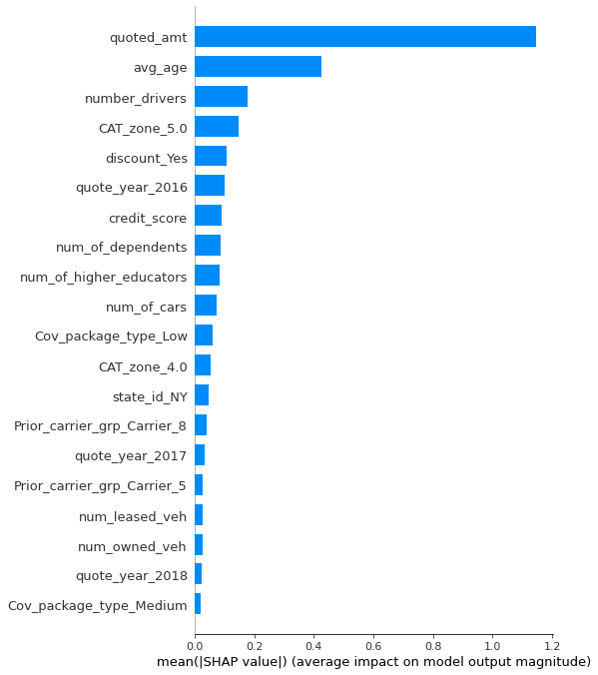
XG-Boost turned out to be the best model
Variable Importance
With the aim of having lower False Negatives, we chose XG Boost as our best model

Slide 15
Target Variable, Feature Selection and Data Splitting
Feature Selection
Target Variable
Quote Converted?
1 – Yes
0 – No
Variable Group | Variable name
Demographics | Age
 | Number of drivers, dependents
 | Credit Score
 | Location(state, CAT zone)
Vehicle | Number of Cars(leased, owned)
Policy | Quoted Amt
 | Coverage Pack Type
 | Discount
Models Explored
Logistic Regression
XG Boost
Decision Tree
Random Forest
KNN
Balancing dataset
Over-sampling
Under-sampling
KPIs tracked
AUC
Accuracy
Recall
Precision
Data Split Ratio
Training : Test :: 80: 20
Note:

Slide 16


Slide 17
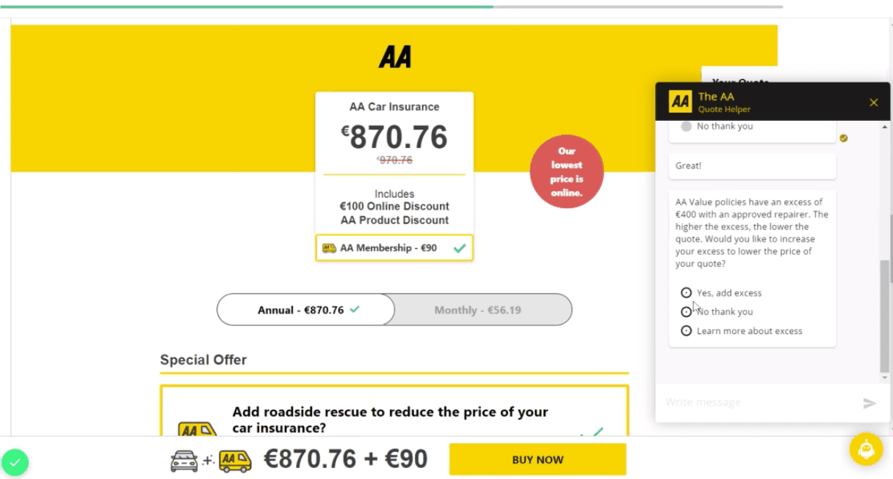
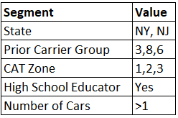
Customer segmentation through Chatbot/Automated voice caller
Using customer conversion data analysis, we can segment customers into buckets based on their details and associated conversion probabilities.
For such customized interactions, we can use chat boxes on our website to direct customer segments to trained salespeople for positive conversion results.
Combination of these segments constitute 12% of data. Increasing conversion rate in this pool by 4% increases overall conversion rate by 0.5%
AA Ireland, one of the largest providers of insurance uses chatbot to answer customer queries and provide quote online which increased their conversion rate by 11%
https://servisbot.com/ai-case-study/

Slide 18

Multi-Policy Insurance (Home and Auto)
In addition to the data suggested variables, converting customers who are already part of Peace of Mind should be easy
One such solution would be to offer multi-point insurance as a single product with many benefits, such as simplifying bills, saving on premiums, and offering a single deductible.
Allstate Auto insurance says that people can save up to 25% when they bundle home and auto insurance.
https://www.experian.com/blogs/ask-experian/should-you-bundle-your-home-and-auto-insurance/

Slide 19
Reward points
Boosting the service value of the policy is one way to increase the conversion rate. One such value addition is rewarding customers.
A referral program is one way of improving conversion rates by rewarding our existing customers and acquiring new ones to ensure conversion rates are linked to revenue and margins.
Providing reward points redeemable for premium payments is another way to add value to the policy quote. Therefore, there may be a higher likelihood of the policy being converted.

Slide 20
Thank You !!

